Slide 1

US ECONOMIC COMPOSITE MODEL update March 2023
Hans Heytens
hansheytens@hotmail.com
0032 469 19 22 26

Slide 2
HYPERLINK TO PYTHON CODE
DataCamp (models in Python can be found here)
https://app.datacamp.com/profile/hansheytens

Slide 3
GOAL
Create a simple monthly view on the US macroeconomic situation using mainly macroeconomic indicators. Back test simple rule, no optimization of parameters afterwards.
Straightforward, simple US monthly trading model based on 5 macroeconomic indicators: 5 sub-models (based on leading economic indicators except unemployment). Equal weight the models.
Global macro environment based on composite leading indicator ➔ global OECD-diffusion model
US macro environment based on composite leading indicator ➔ US OECD-impulse + price trend
US macro environment based on composite leading indicator ➔ US LEI model
US macro environment based on the yield curve ➔ US yield curve diffusion model
US macro environment based on unemployment ➔ Sahm-rule model + price momentum
MODELS (PYTHON)
Composite Model: equal weight the 5 sub models below:
Global OECD Diffusion Model:
If % of countries with rising oecd-indicator < 50%: T-bills, SPX otherwise
US OECD-impulse/Price Trend Model:
If short-term change in US OECD-indicator is negative: switch to trend-following modus. If not, stay invested in S&P500
If S&P500 long-term price trend is negative: T-bills. If not: stay invested in S&P500.
US Leading Economic Index (LEI) Model:
If 6m-change in LeiYoY is positive: invest in S&P500, else:
If 6m-change is negative, but recovering (1m-change of 6m): invest in S&P500
If 6m-change is negative, but worsening (1m-change of 6m): invest in T-bills
US Yield Curve Diffusion Model:
If percentage of term spreads that are negative > 20%: T-bills. Else, invest in S&P500
Sahm-Rule: US Recession starts if U3 is 0.5% larger than the 12-month low in U3.
If no recession: invest in S&P500
If recession: switch in momentum-modus:
Invest in the asset class (S&P500, Treasuries or T-bills) with the best composite momentum score.

Slide 4
MOTIVATION
I publish my work and learning process because of the protégé effect. I also encourage my readers to check my code, logic and discuss.
Teaching and/or explaining a process to others is the best way to learn for myself.
I encourage my readers to check my code, logic and search for any errors/mistakes.
INTENDED USE
This notebook is for illustrative and education purposes only. Feel free to use this code for these purposes.
The logic and/or python code might contain errors. All mistakes remain the author's fault. If you find any, let me know so I can rectify
LIMITATIONS AND FUTURE CHALLENGES:
Add some more pure eco-indicators on other domains such as US consumer activity, US production (ISM stuff), US Housing…after back-test
Yield curve model needs work as markets often remain volatile first year after yield-curve normalization. Signal might be adjusted to take this into account. This is however overfitting as we noticed this after running the normal model.
Sahm-rule popular rule but international evidence shows weak signal for recessions in other countries. US dynamic labor market, hence maybe better. In any case, we might use better and faster labor indicators: jobless claims, % states with rising unemployment, manufacturing employment,…to be tested…
Keep it simple in this composite eco-model: no multi-variate regressions or machine learning stuff. Just individual models – back-tested – on eco indicators only. Challenge is data going back far enough.
CREDITS
Yield curve diffusion: I first saw yield curve breath as an indicator couple of years ago in a post made by Otavio Costa (Crescat Capital)
Sahm-rule: Claudia Sahm

Slide 5
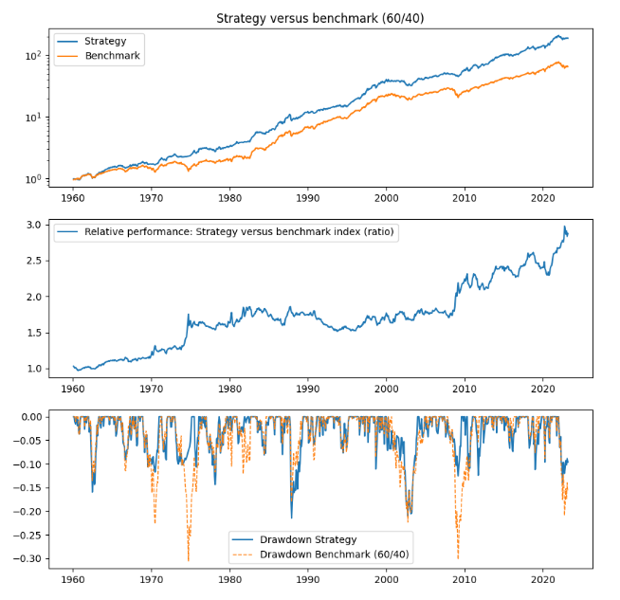
Composite Model (5-submodels)
Current signal?
4 models Risk-off:
Global OECD diffusion
OECD Impulse + Price trend
US Lei
US Yield curve
1 model Risk-on:
Sahm-rule + price momentum
Signal:
20% S&P500
80% T-bills

Slide 6
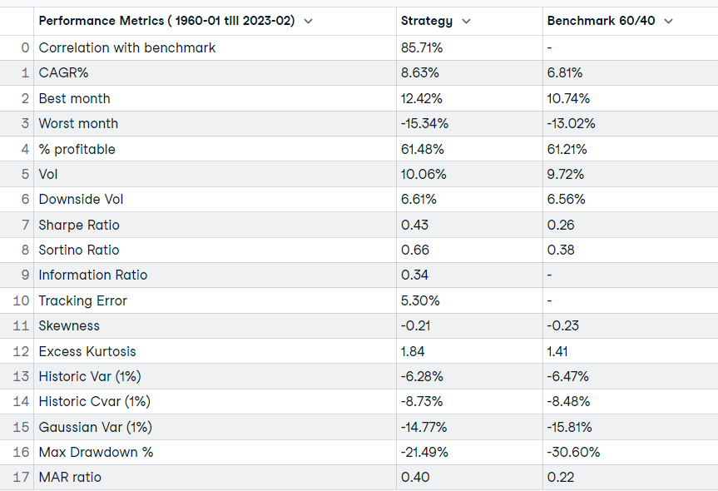
Composite Model (5-submodels)

Slide 7
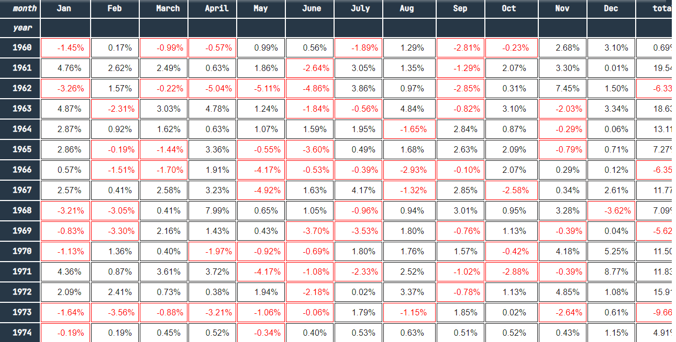
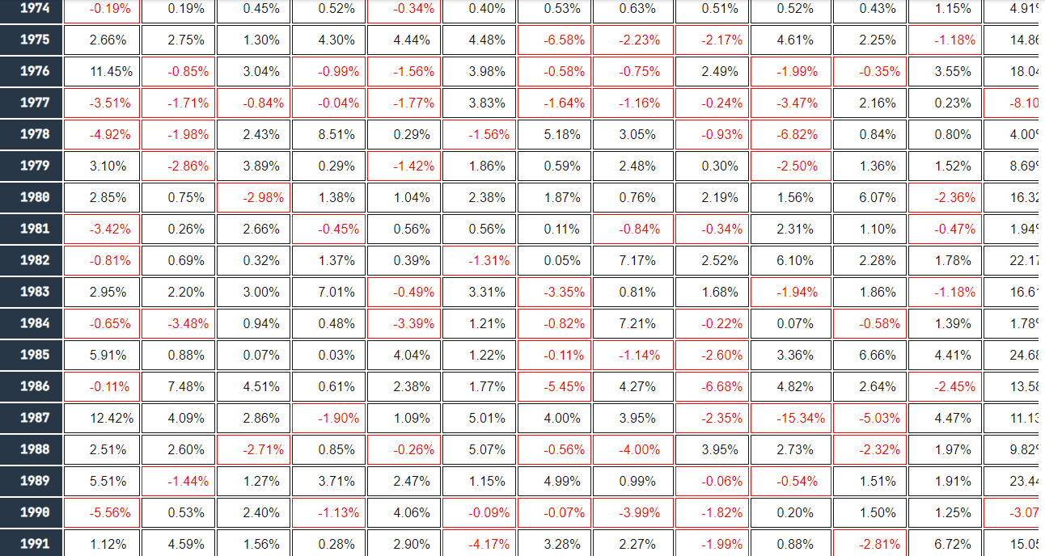
Composite Eco Model (5-submodels)

Slide 8
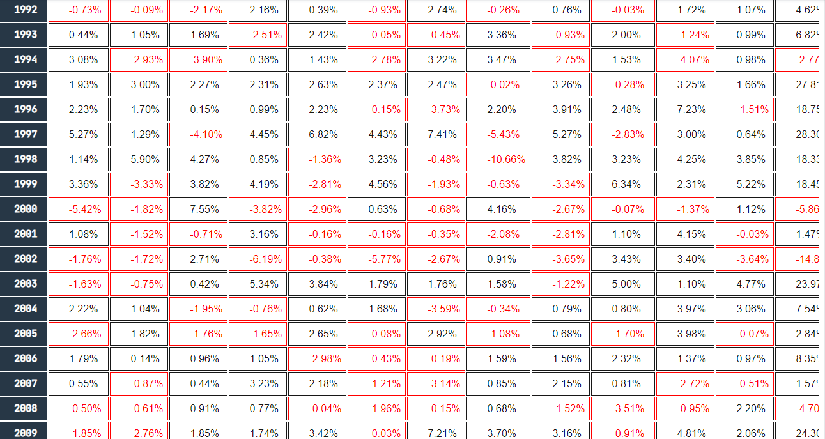
Composite Eco Model (5-submodels)

Slide 9
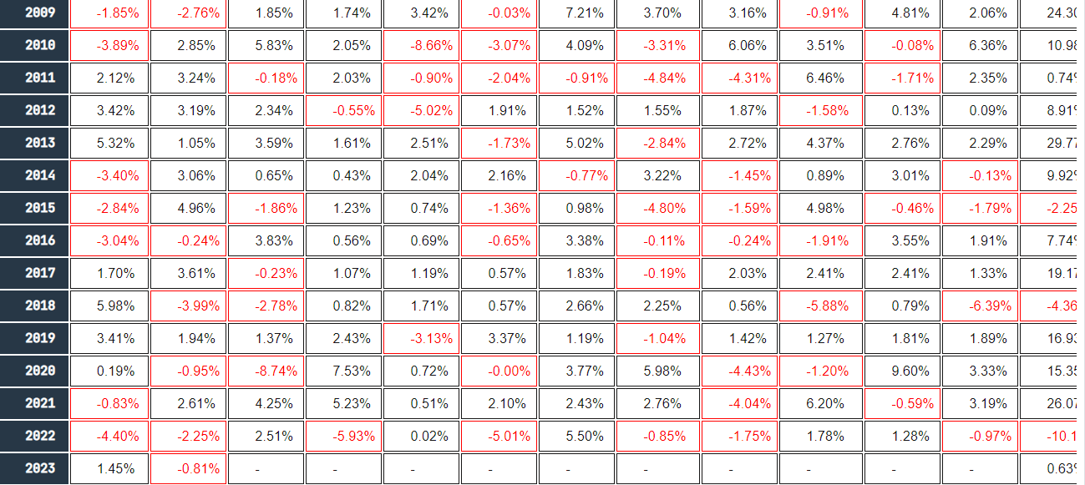
Composite Eco Model (5-submodels)

Slide 10
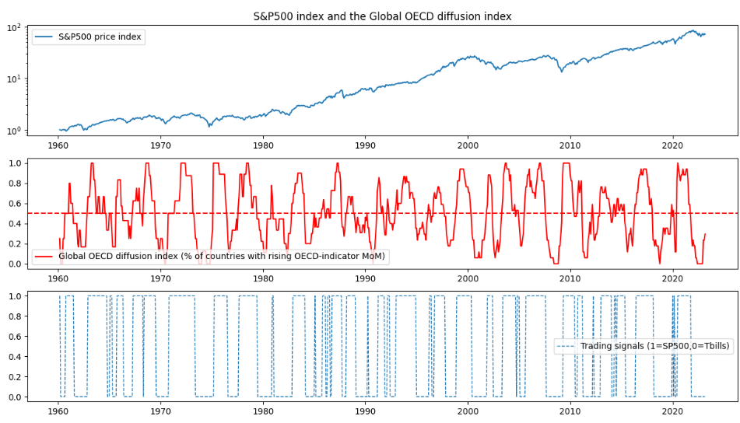
Global OECD-diffusion model
Current signal?
% of countries with rising OECD-indicator: 29%
Signal: T-bills

Slide 11
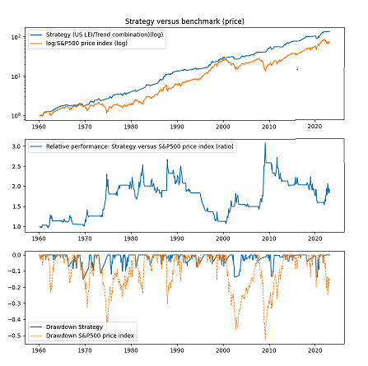
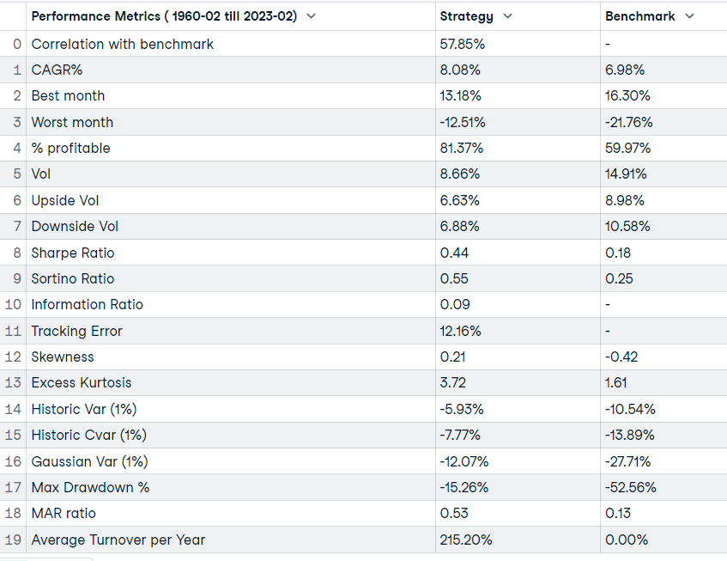
Global OECD-diffusion model

Slide 12
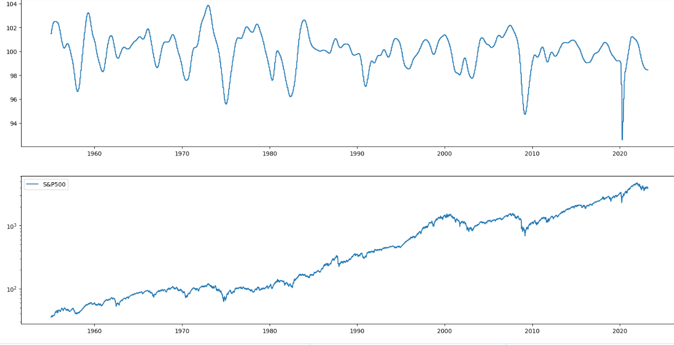
US OECD Impulse + Price-trend model
Current signal?
Short-term change in US OECD: negative ➔ trend-following modus
S&500 long-term price trend: negative
Signal: T-bills

Slide 13
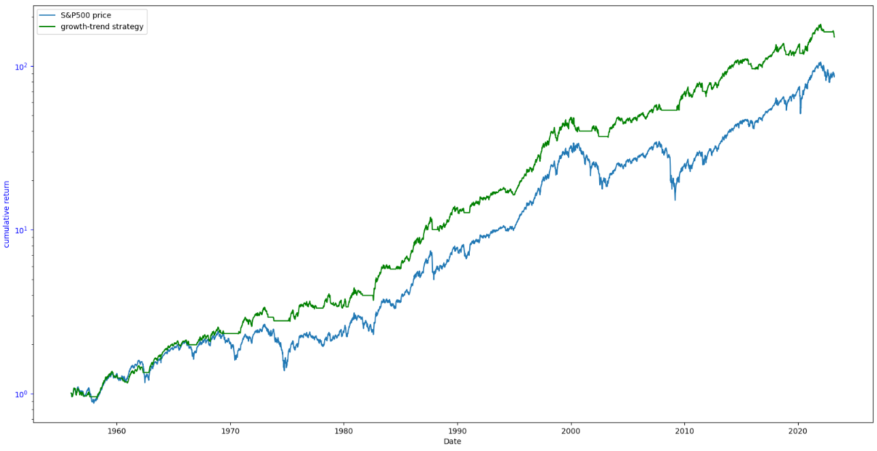
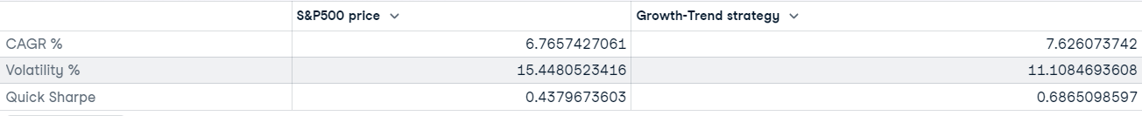
US OECD Impulse + Price-trend model

Slide 14
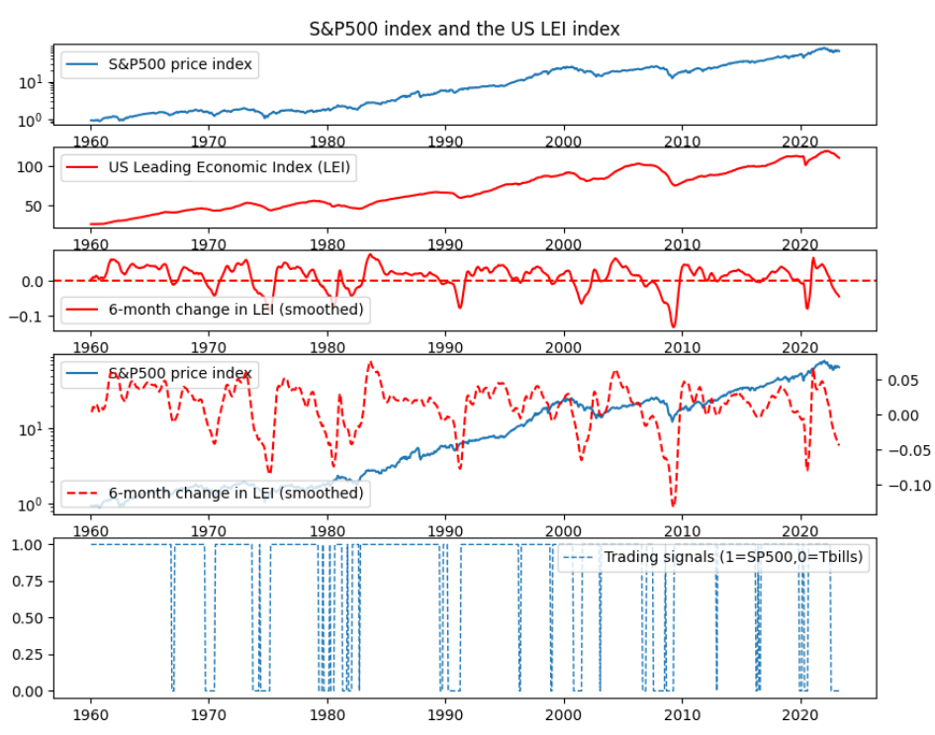
US Leading Economic Index (LEI) model
Current signal?
6m-change in US LEIYoY: negative
Short-term change in 6m-change: negative
Signal: T-bills

Slide 15
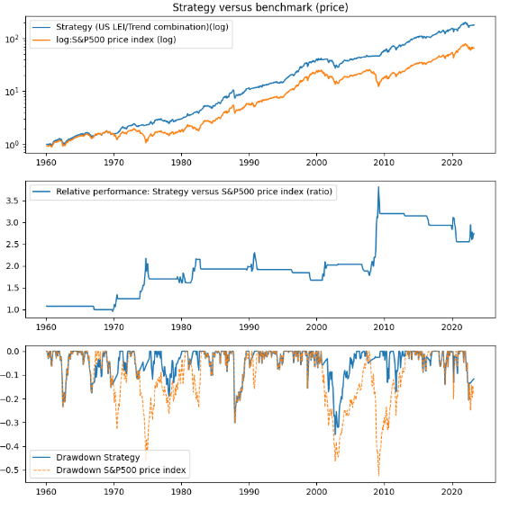
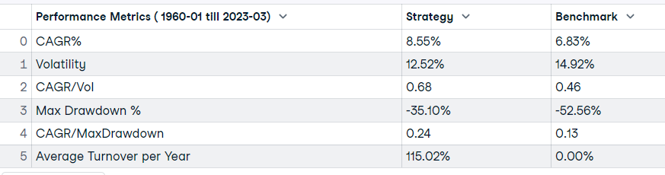
US Leading Economic Index (LEI) model

Slide 16
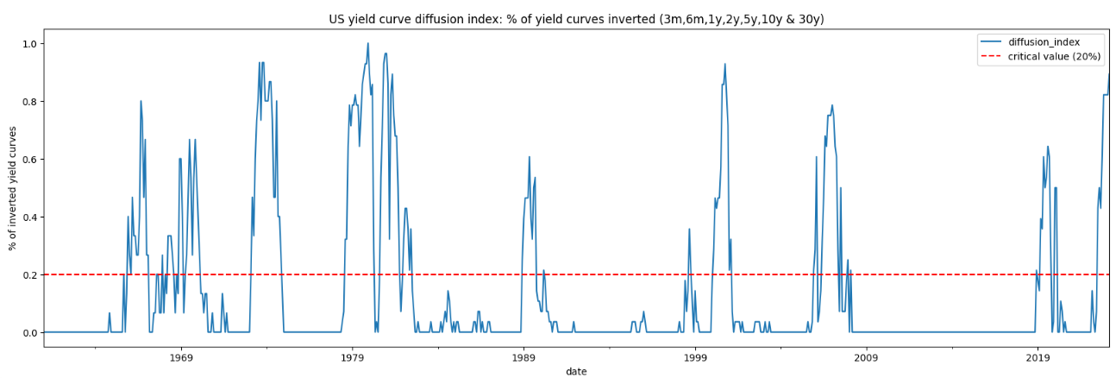
US Yield Curve Diffusion Model
Current signal?
% of inverted yield curves > 20%
Signal: T-bills

Slide 17
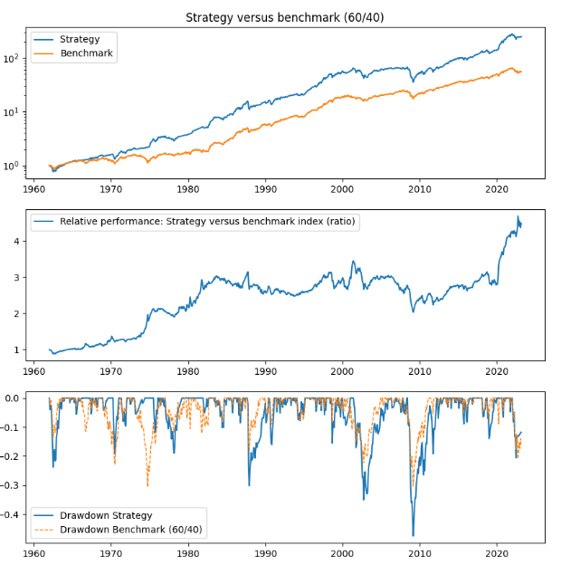
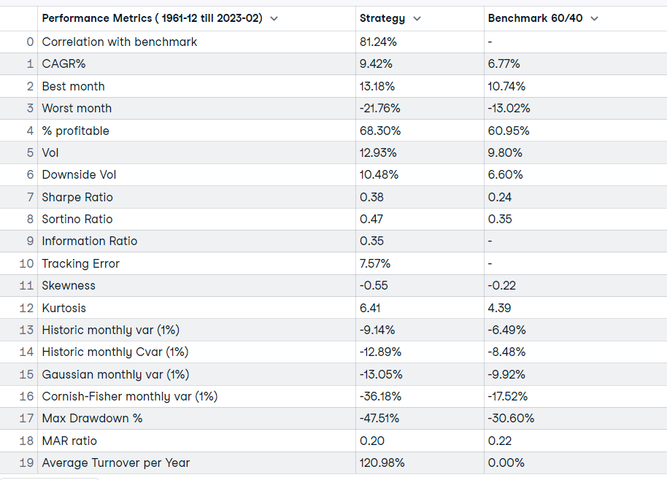
US Yield Curve Diffusion Model

Slide 18
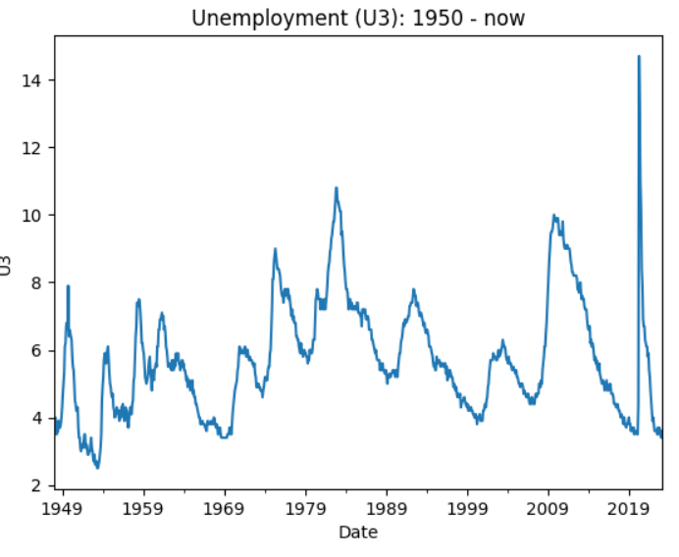
US Sahm-rule model + Price momentum
Current signal?
Sahm-rule= no recession
Signal: S&P500

Slide 19
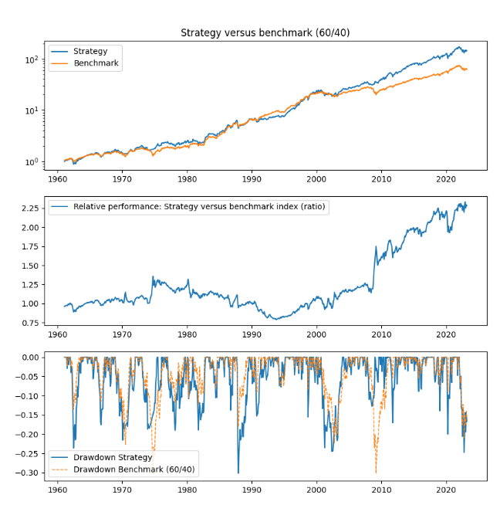
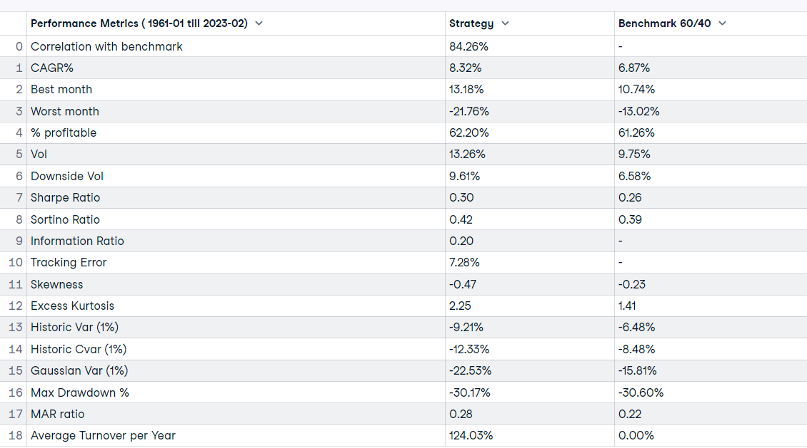
US Sahm-rule model + Price momentum

